Slide 1
The DBA's Field Guide to ORMs A Survival Kit
Jay Robinson
he/him
Software Engineer
Salesforce

Slide 2



Jay
Robinson
he/him
Software Engineer
Salesforce
In the IT industry for more than 30 years, Jay is a C# and T-SQL developer who enjoys the challenges of supporting complex data-centric applications at scale.
With a previous decade-long tour at Salesforce under his belt, he has recently returned to the SaaS trailblazer as a senior engineer with the Marketing Cloud.
Obsessed with speed, when he's not writing code that makes data go fast, he's talking about it at data community events.
@downshiftdata.bsky.social
downshiftdata.arksoftware.net
www.linkedin.com/in/downshiftdata
Notes:
Peter

Slide 3
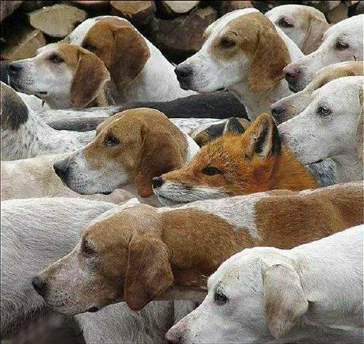
Is this you?
Dev
Dev
Dev
Dev
Dev
Dev
Dev
Dev
DBA
Dev
Dev
Dev
original image source unavailable - see https://www.snopes.com/fact-check/fox-and-the-hounds/

Slide 4
Agenda
Umm... what's an ORM?
The demo and design patterns
It all starts with ADO.NET
A look at Dapper
Entity Framework Core
Data First v Code First
Honorable mentions

Slide 5
Disclaimers
This is a broad - and not deep - survey of various ORMs.
My opinions are based on my experience as a software developer - but they're still just opinions.

Slide 6

What is an Object-Relational Mapping Tool (or ORM)?
An abstraction layer for writing to and reading from a relational database
Purposes:
To simplify data access code
To reduce development time
To support code modularization and testing

Slide 7

Design Patterns - An Intro to the Demo
The demo (ormc) is a REST API written in C#
The API follows the Model-View-Controller (MVC) pattern
The ADO.Net and Dapper examples use the Repository pattern
The Repositories follow Command and Query Responsibility Segregation (CQRS)
The API uses Dependency Injection
The Swagger UI is used to perform the demos
The database is deployed via a PowerShell script
Available at https://github.com/downshiftdata/ormc

Slide 8

The Evolution of ADO.NET
Visual Basic: DAO, then RDO, then ADO
.NET Framework 1.0 introduces ADO.NET
System.Data and System.Data.SqlClient namespaces
DataSets and DataAdapters
System.Data.SqlClient.SqlBulkCopy
.NET Framework 3.5 introduces LINQ to SQL
Query Syntax or Method Syntax?
.NET Core introduces Microsoft.Data.SqlClient

Slide 9
ADO.NET Today
Long-Term Support (LTS): Microsoft .NET 8 (expires 2026-11-10)
Latest: Microsoft .NET 9 (released this month, expected to expire 2026-05)
.NET Framework 4.8.1 (tied to Windows Server, indefinite expiration)

Slide 10
Demo: ADO.NET

Slide 11
ADO.NET Conclusions
Not really an ORM - It is the "base layer" of .NET
Very common, due to age, lack of early options
Best option for raw performance
Be wary of:
Homebrew abstractions
Not-Invented-Here Syndrome

Slide 12

The Emergence of Dapper
Originated at Stack Overflow around 2011
https://github.com/DapperLib/Dapper
Apache License 2.0
Like ADO.NET, but better

Slide 13
Demo: Dapper

Slide 14
Dapper Conclusions
Less code than ADO.NET
Effectively as fast as ADO.NET
Still pairs nicely with CQRS
Dapper and ADO.NET can coexist
> 378 million downloads on NuGet

Slide 15

The Emergence of Entity Framework
Released with .NET 3.5 SP1 in 2008
In 2013, EF 6 went open source on GitHub
EF Core (a complete rewrite) released alongside .NET Core in 2016
Apache License 2.0
Same versions as .NET - Current LTS is version 8

Slide 16
Data First or Code First?
In Data First, the database defines the application layer
Database changes inform the Scaffolding
In Code First, the application layer defines the database
Database changes are handled through Migrations

Slide 17
Demo: Entity Framework - Data First

Slide 18
Demo: Entity Framework - Code First

Slide 19
Entity Framework Conclusions
Data First:
Ad hoc SQL by default
Harder implementation
Simple design by default
Know the Scaffolding
Code First:
Ad hoc SQL by default
Easier implementation
Bad design by default
Know .NET and C#

Slide 20

Honorable Mentions
Belgrade
https://github.com/JocaPC/Belgrade-SqlClient
Minimalist and performance-minded
NHibernate
https://github.com/nhibernate/nhibernate-core
Associated with RedHat
Established, stable, good for VB.NET and F#
And don't forget about caching!

Slide 21


Slide 22
Jay Robinson
@downshiftdata.bsky.social
downshiftdata.arksoftware.net
www.linkedin.com/in/downshiftdata

